Slide 1


Devops

Slide 2
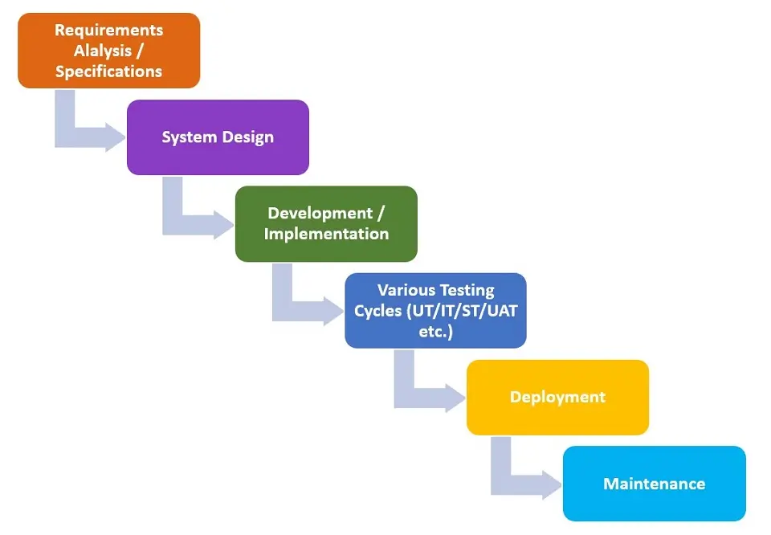
Water fall life cycle.

Slide 3
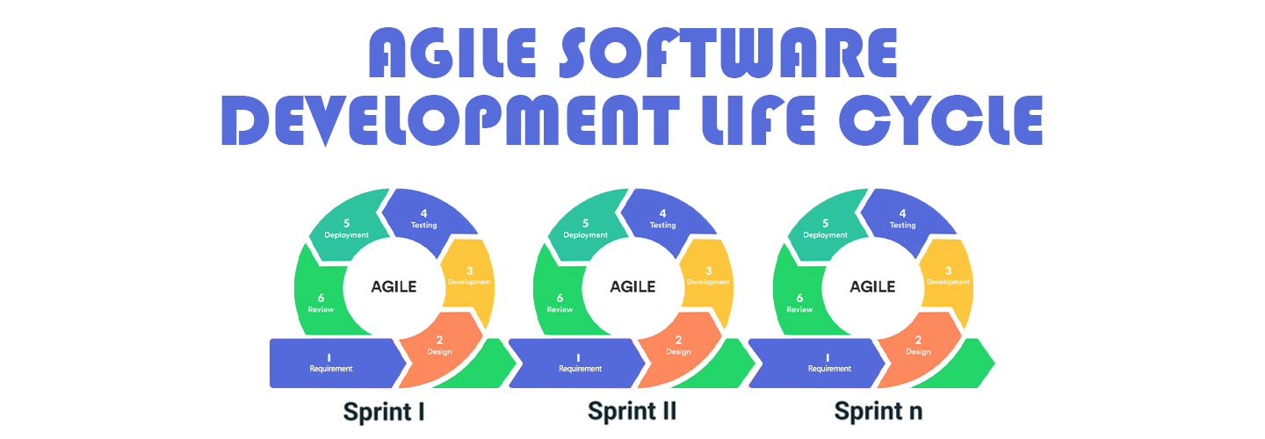

Slide 4
Challenges in Traditional Siloed Approaches
Disconnected Workflows
Slow Deployment Cycles
Manual processes
Inconsistent Environments
Lack of Flexibility and Scalability

Slide 5
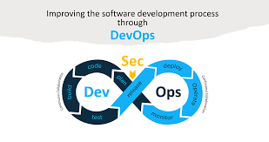
What is Devops
DevOps, a portmanteau of "Development" and "Operations," is a set of practices, cultural philosophies, and tools that aim to improve collaboration and communication between software development (Dev) and IT operations (Ops) teams.

Slide 6
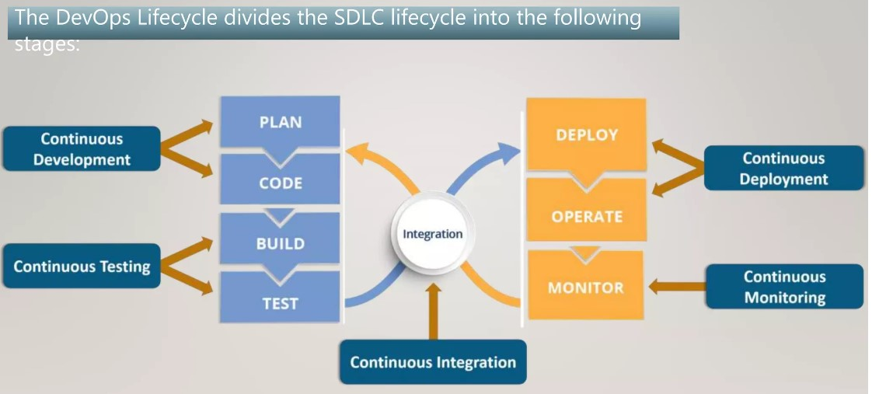
DevOps Lifecycle

Slide 7
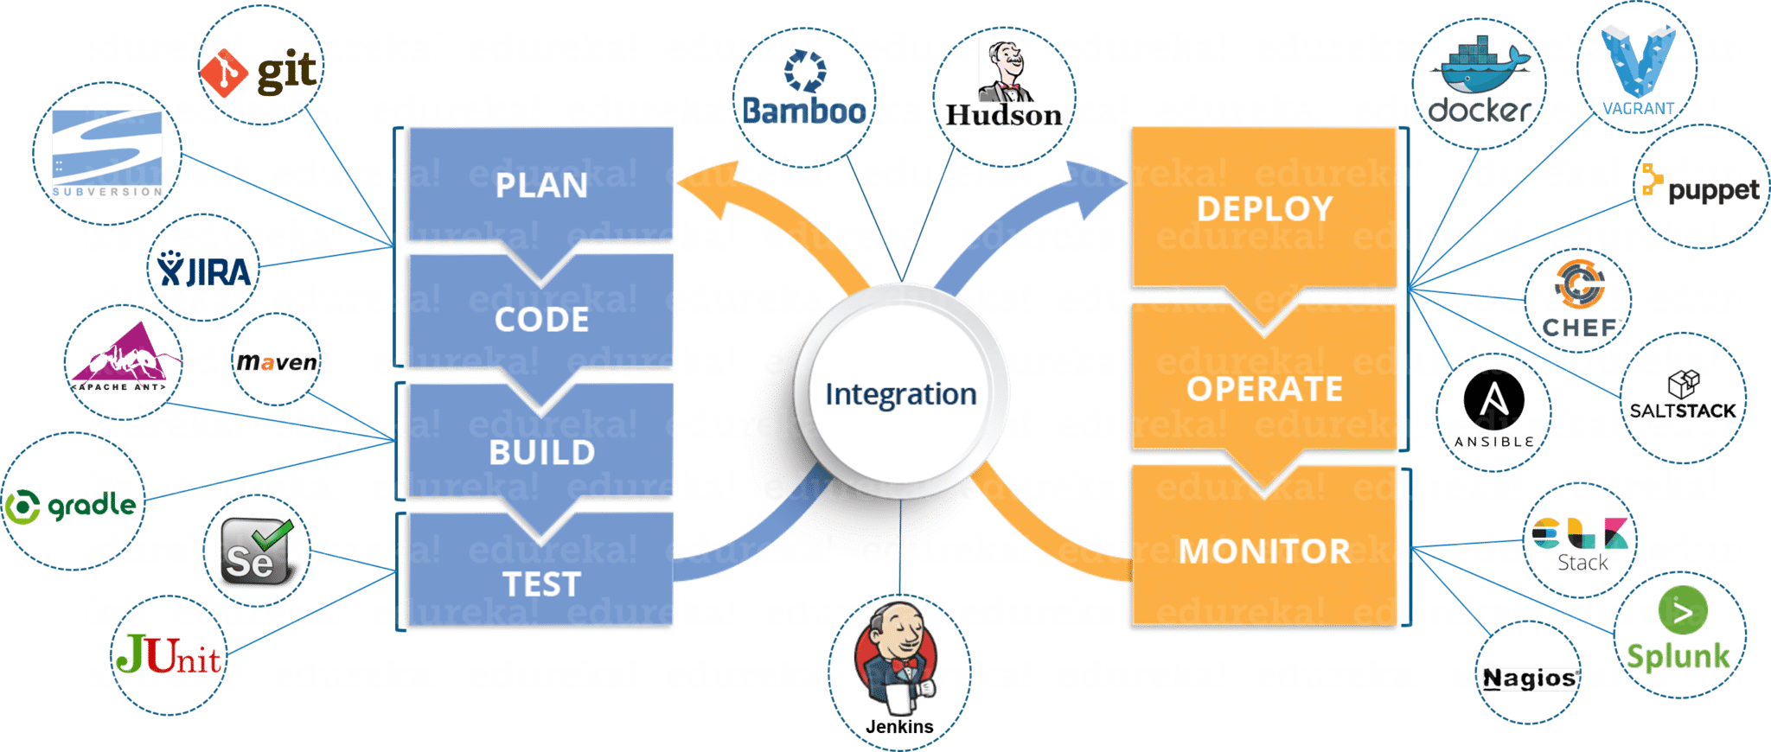
Tools Used in DevOps

Slide 8
Important Phases in DevOps Lifecycle
Continuous Development
Continuous Testing
Continuous Intregation
Continuous Deployment
Continuous Monitoring

Slide 9
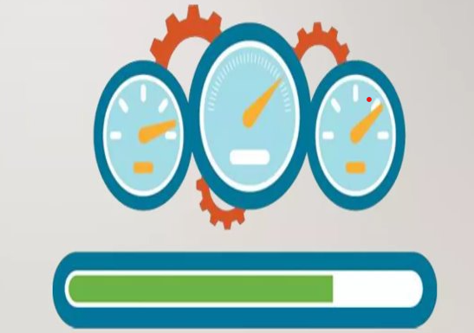
Continuous Development of App code.
This stage involves committing code to version control tools such as Git or SVN for maintaining the different versions of the code, and tools like Ant, Maven, Gradle for building/ packaging the code into an executable file that can be forwarded to the QAs for testing

Slide 10
Infrastructure as a code

Slide 11
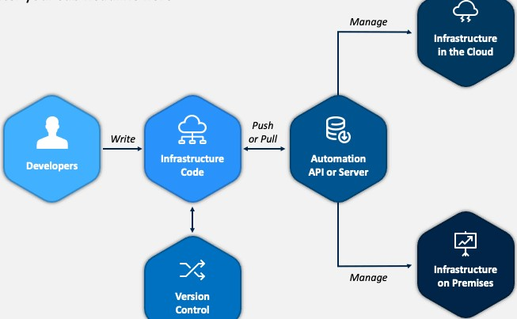
Introduction to IaC
Definition of Infrastructure as Code
Infrastructure as Code (IaC) refers to the practice of managing and provisioning computing infrastructure through machine-readable scripts or code.
Importance in modern software development and deployment
IaC enables automation, consistency, and scalability in deploying and managing infrastructure resources.

Slide 12
router
Internet port
Web Server
S
Load Balancer
LL.B
App Server
DB Server
Subnet-1
public
Subnet-2
private

Slide 13
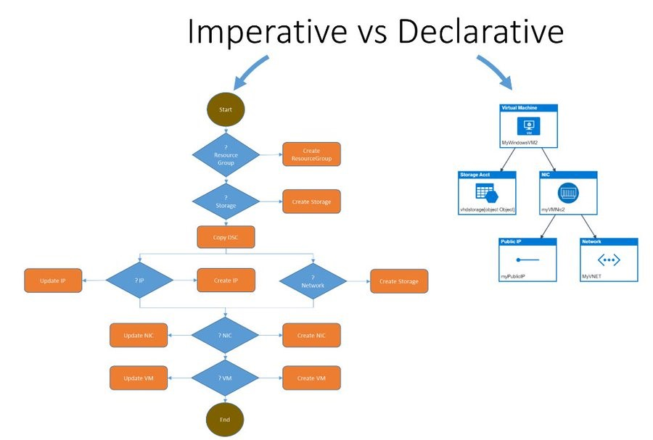
Declarative vs. Imperative Approaches
Declarative — you define the desired state of the final solution.
Imperative — you define the steps to execute in order to reach the desired solution.

Slide 14
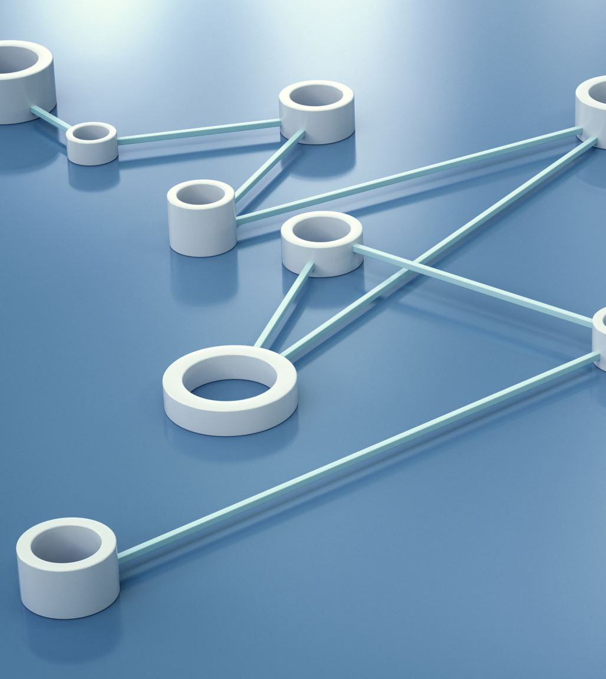
Why and When to use
Why?
Consistency in deployments
Scalability and flexibility
Version control and rollback capabilities
Collaboration and reproducibility
When?
Infrastructure management
Configuration management with somewhat limited infrastructure management capabilities
Configuration management

Slide 15

IaC Tools
Terraform: "Declarative, multi-cloud provisioning tool.
Ansible: "Agentless configuration management and automation tool.
CloudFormation: "AWS-specific provisioning tool.
Puppet: "Configuration management and automation tool.
Chef: "Infrastructure automation framework.

Slide 16
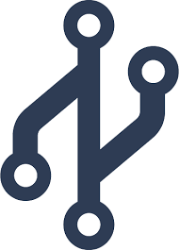
Version Control System

Slide 17
Introduction to VCS
Definition of VCS:
Version Control Systems are tools that manage changes to code, documents, and other files, enabling multiple contributors to collaborate efficiently.

Slide 18
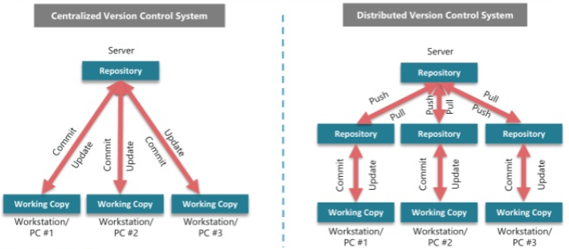
Types of VCS

Slide 19
Benefits of VCS
Collaboration
Versioning
Traceability
Integration with CI/CD

Slide 20
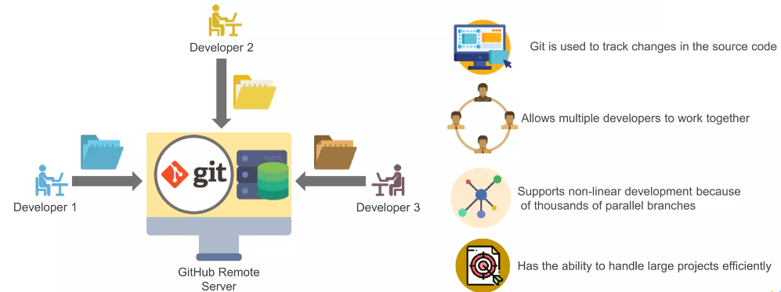
Overview of Git

Slide 21
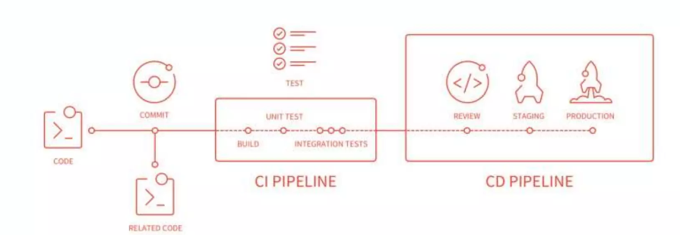
Git in CI/CD Pipelines
Implementing CI
Configure CI Pipeline
Trigger CI on Git Events
Implementing CD
Automate Deployment
Rollbacks and Monitoring
Automating Versioning

Slide 22
Tools used for version control
1.Git
2.Githud
3.Gitlab
4.Bitbucket.
5. mercurial.
6. TFS
7.Subversion (SVN)
8.AWS code commit.

Slide 23

CI/CD

Slide 24
What is CI/CD
Continuous integration (CI) :
Continuous Integration is the practice of automatically and frequently integrating code changes from multiple contributors into a shared repository.
Continuous Deployment (CD) :
Continuous Delivery is the practice of automatically and consistently delivering software to a staging or production environment after passing through the CI process.

Slide 25
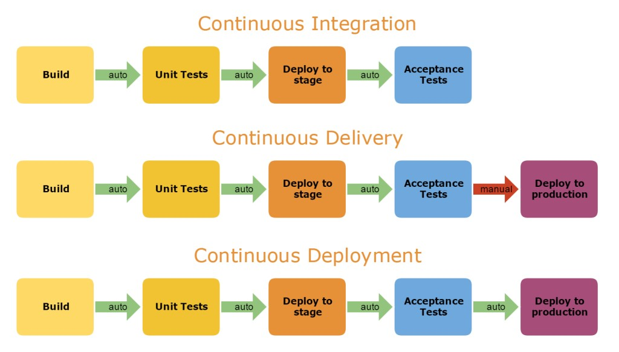
Continuous delivery V/S Continuous Deployment

Slide 26
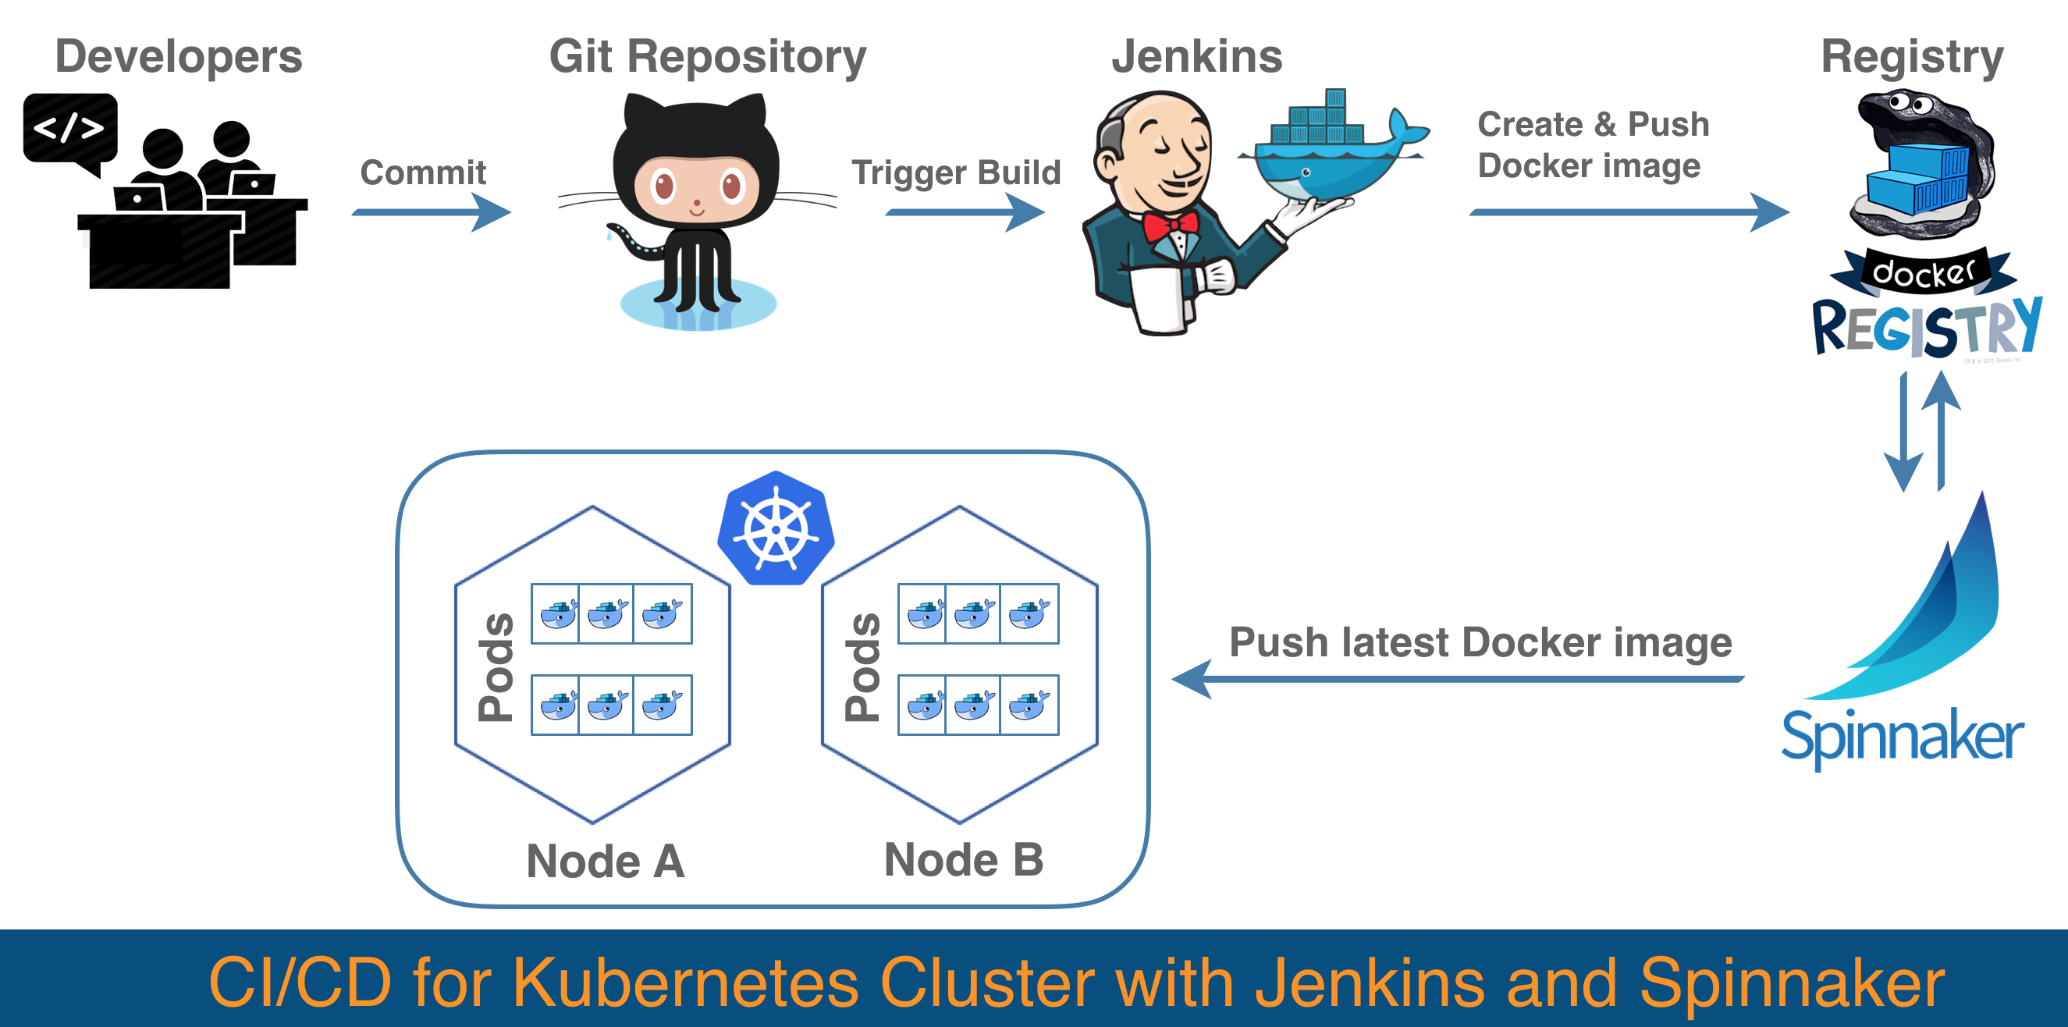
Working of CI/CD with Jenkins

Slide 27
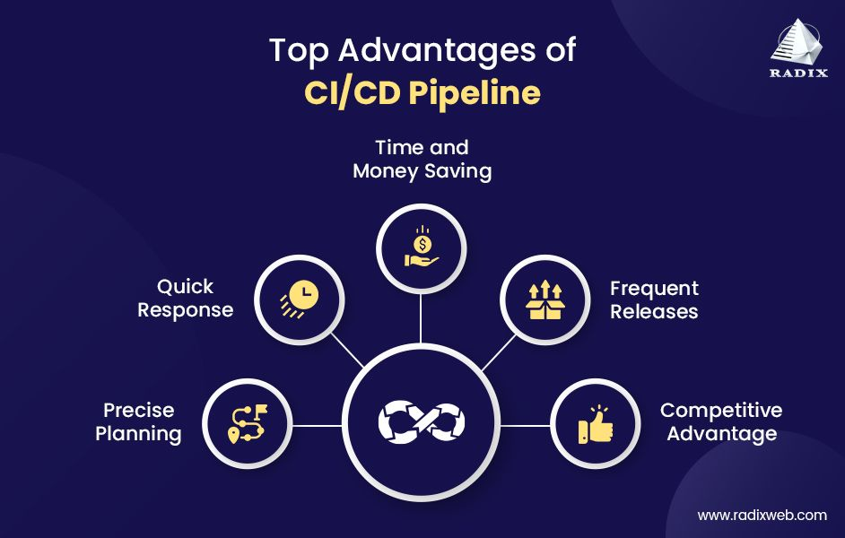
Advantages of CI/CD

Slide 28
Some Tools used to perform CI/CD
Jenkins
Git lab CI/CD
Git hub Actions
Travis CI
Circle CI
Team city
Go CD
AWS code pipeline
Azure Deveops (formerly VSTS)

Slide 29
History
Before Docker we have Dedicated servers and VM’S.
In Dedicated server’s
Application No 1
Application No 2
OS
OS
Physical server no 1
Physical server no2

Slide 30
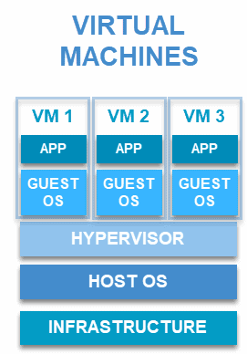
In Virtual machines

Slide 31

Disadvantages
Unnecessary installing operating system multiple times and memory get wasted.
Using multiple resources and doesn’t support Automatic control system.
Compatibility code issues in Different Environment.
To overcome above draw backs we going Docker.

Slide 32
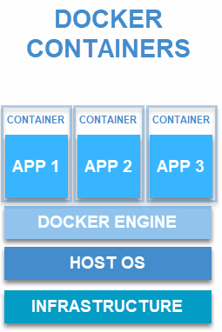
What is Docker
Docker is a platform that enables developers to automate the deployment of applications inside lightweight, portable containers.
It operate on Alpine Linux os, which is of 5MB size, This is the smallest operating system in world.

Slide 33
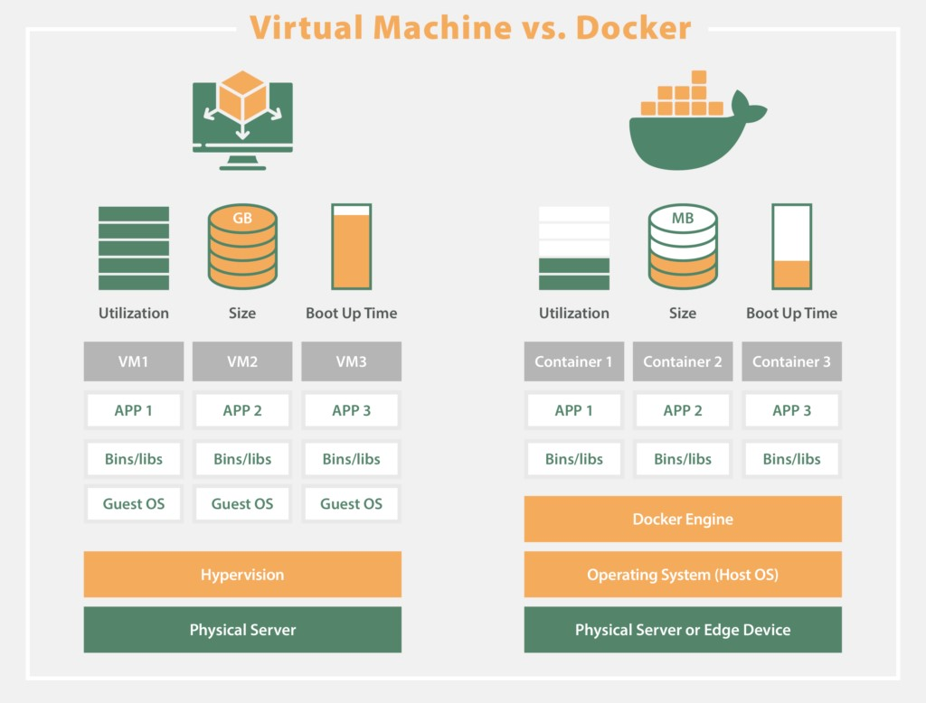
VM’S VS Docker.

Slide 34
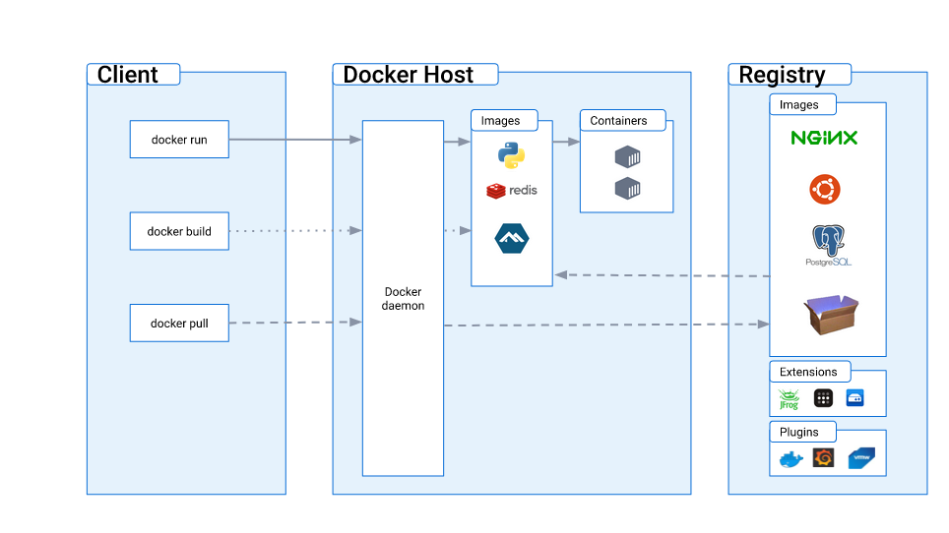
How does Docker work

Slide 35
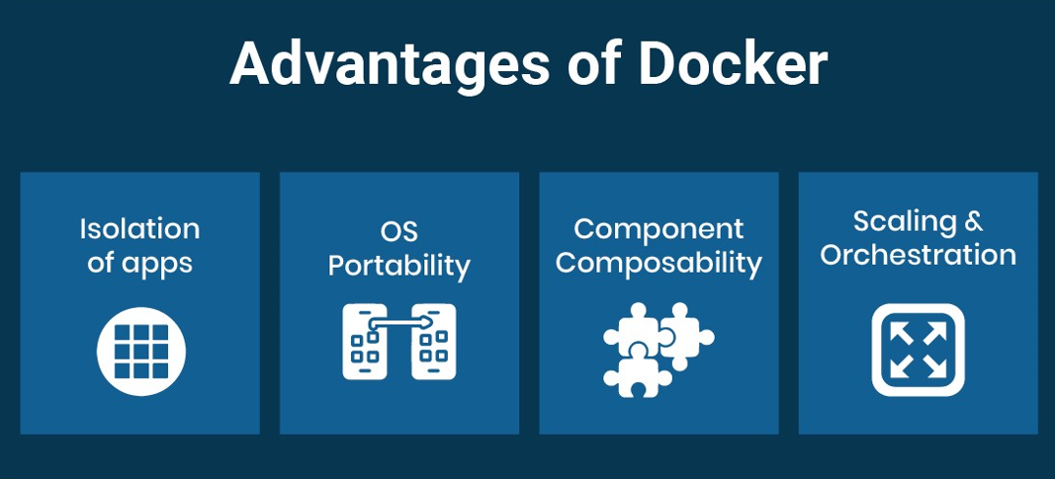

Slide 36
What is Kubernetes
Kubernetes, often abbreviated as K8s, is an open-source container orchestration platform that automates the deployment, scaling, and management of containerized applications.

Slide 37
Operation it can perform.
Container orchestration.
Scaling.
Load balancing.
Service Discovery and load balancing.
Rolling Updates and Roll backs.
Self-healing.
Declarative configuration.
Secretes and Configuration management.

Slide 38
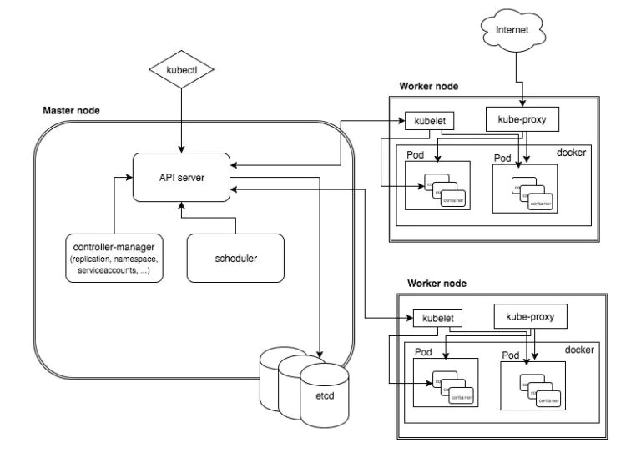
How does Kubernetes work.

Slide 39
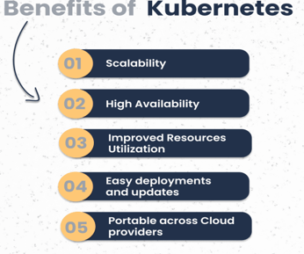

Slide 40
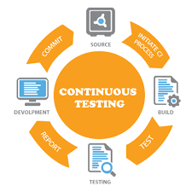
Continuous Testing
This phase focuses on automated testing of the developer-pushed application. The integration tool receives the message in the event of an error, and it tells the developer of the problem. The notification is forwarded to the integration tool, which sends the build to the production server, if the test was successful.

Slide 41
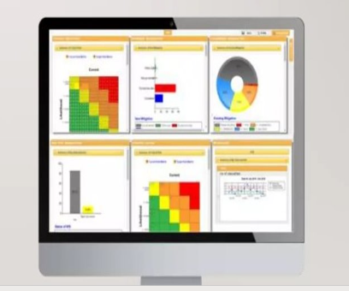
Continuous Monitoring
The stage continuously monitors the deployed application for bugs or crashes. It can also be setup to collect user feedback. The collected data is then sent to the developers to improve the application

Slide 42
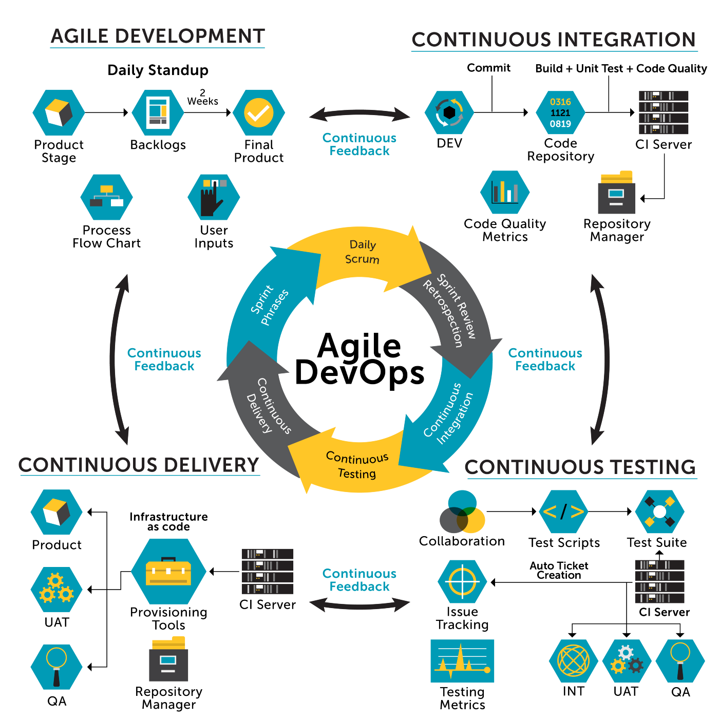
Integrating Agile with Devops

Slide 43

Any Query’s

Slide 44

Thank you.

